Slide 1
Mobile Phone Price Prediction Using Machine Learning
Prepared by : Muskan Malviya

Slide 2
1. Introduction to the Project
This project focuses on predicting the price of mobile phones using machine-learning techniques. The dataset contains specifications such as Model, Colour, Memory, RAM, Battery, Rear Camera, Front Camera, AI Lens, Mobile Height, Processor and Price.
The workflow covers data understanding, preprocessing, feature extraction, exploratory data analysis, model building, evaluation, cross-validation, hyperparameter tuning and feature-importance analysis. The goal is to develop a data-driven approach for estimating mobile phone prices and generating useful pricing insights.

Slide 3
2. OBJECTIVES OF THE PROJECT
Understand the dataset and its features.
Clean and preprocess the data.
Extract useful camera-related numerical features.
Perform exploratory and statistical analysis.
Analyze relationships between features and Price.
Build and compare Linear Regression, KNN, Decision Tree and Random Forest models.
Evaluate models using MAE, RMSE and R² Score.
Perform 5-fold cross-validation and hyperparameter tuning where required.
Identify important predictors using feature and permutation importance.
Select and interpret the final model.

Slide 4
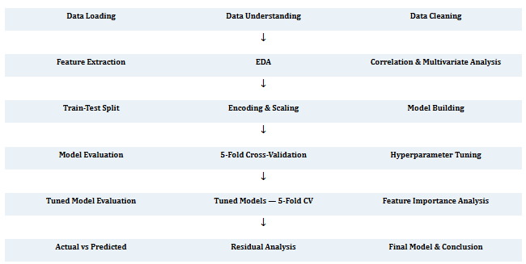
3. Flow Chart of Operations

Slide 5
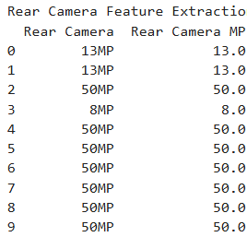
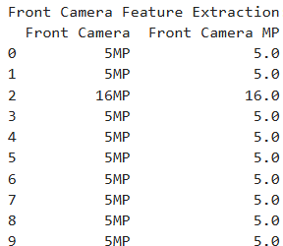
4. Python Codes
Python was used for data preparation, feature extraction, visualization, model development, evaluation, cross-validation, hyperparameter tuning and model interpretation.
Dataset loading and inspection
Camera feature extraction
Train-test split
Categorical encoding and numerical scaling
Model training and evaluation
Cross-validation
Hyperparameter tuning
Feature importance and permutation importance
Actual vs Predicted and residual analysis

Slide 6
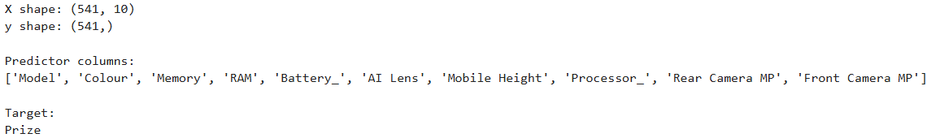
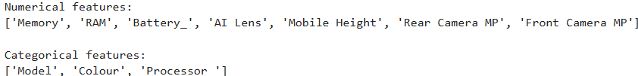
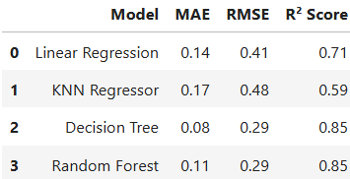
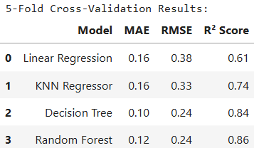
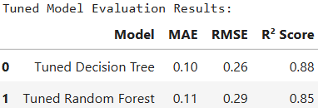
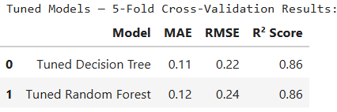
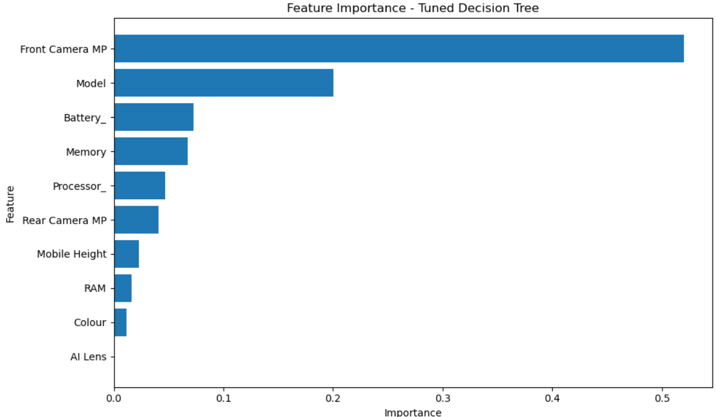
5. Screenshot of the Outputs

Slide 7
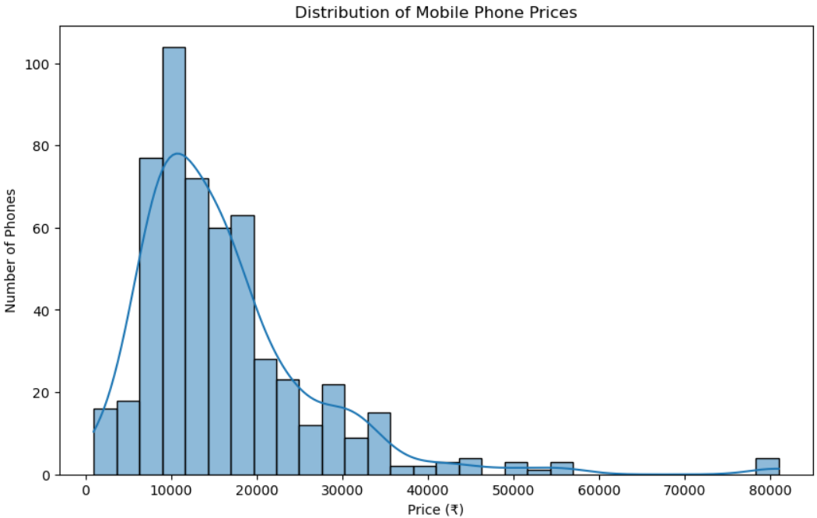
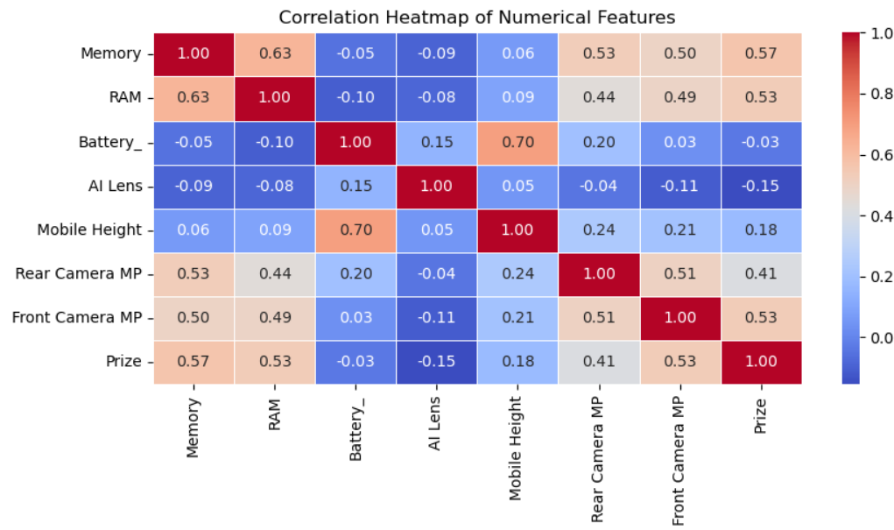
6. Report on EDA
EDA was performed to understand the target variable, feature distributions and relationships with mobile phones Price.
Price Distribution
The histogram confirms that Prize has a positively/right-skewed distribution, which is consistent with the calculated skewness of approximately 2.43.
Most phones in the dataset belong to the lower and mid-price ranges, while relatively few phones are premium-priced.
Correlation Heatmap
Memory, RAM, Front Camera MP, and Rear Camera MP appear to have the strongest linear associations with mobile-phone price.

Slide 8
7. Learning Outcomes
Data cleaning and preprocessing
Exploratory Data Analysis and visualization
Feature extraction
Correlation, VIF and Mutual Information
Categorical encoding and scaling
Machine-learning model building
Model evaluation and cross-validation
Hyperparameter tuning
Feature and permutation importance
Interpretation of predictions, residuals and limitations

Slide 9
8. Conclusion
The project successfully developed a machine-learning approach for mobile phone price prediction. Multiple models were compared, followed by 5-fold cross-validation and hyperparameter tuning.
The Tuned Decision Tree was selected as the final model with normalized test MAE 0.10, normalized test RMSE 0.26 and test R² Score 0.88. Its 5-fold CV results were normalized MAE 0.11, normalized RMSE 0.22 and R² Score 0.86.
Front Camera MP was the strongest feature in the final model's feature-importance and permutation-importance analyses, while Memory had the strongest Pearson correlation with Price among numerical features.

Slide 10
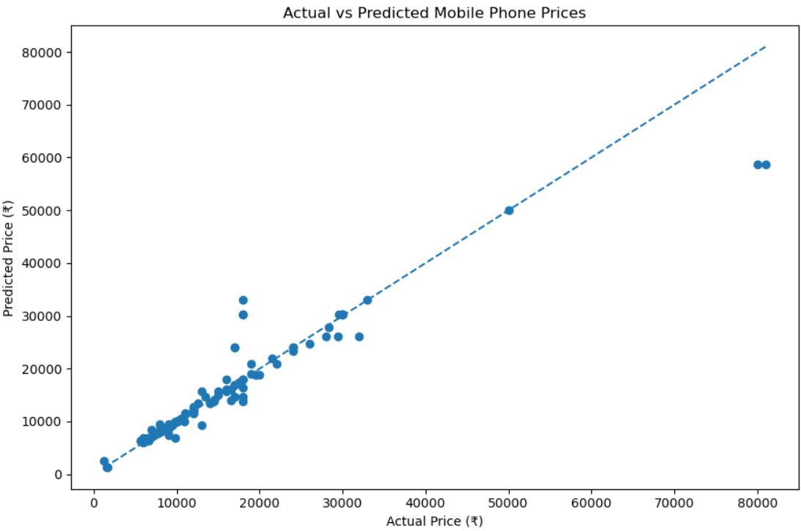
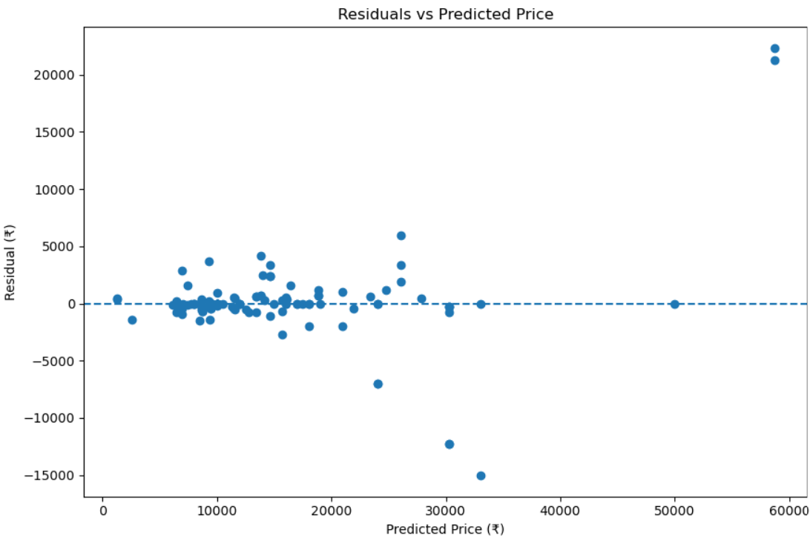
The model performs well overall but has difficulty predicting some extreme/high-priced phones.
Actual VS Predicted Price
Most predicted prices are reasonably close to the actual prices, indicating good overall model performance.
Residual Analysis
The residual plot indicates good performance for most observations, with larger errors concentrated in a small number.
of cases.

Slide 11
9. Business Recommendations
Use camera specifications, Memory, Battery, Processor and RAM when designing price segments.
Consider multiple specifications together rather than relying on one feature.
Use the Tuned Decision Tree as a supporting tool for price estimation.
Use predictions to support new-product and variant pricing decisions.
Review high-priced phone predictions carefully because errors are larger for some extreme observations.
Combine ML predictions with market demand, competition and business knowledge.
Retrain the model periodically with updated market data.

Slide 12
10. Books and Websites Used for Research
Project Reference Material
Project Feature Engineering PDF — Project scenario, objectives, methodology, feature extraction requirements, model-building requirements and report guidelines.
Research Links Provided in the Project Instructions
Feature Extraction Techniques
What is Feature Extraction
Machine Learning Feature Extraction Techniques
Encoding Techniques
Additional Assistance
ChatGPT (OpenAI) — Used for understanding concepts, interpreting outputs, troubleshooting Python code, and organizing the project report.

Slide 13
Thank you

